Slide 1
Welcome

Slide 2
Testimony: George Papanek

Slide 3
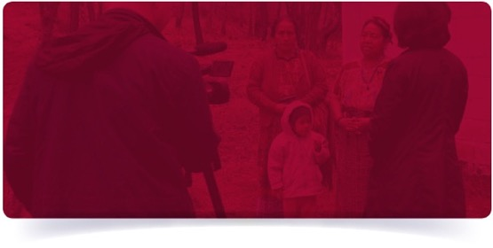
Leading Change Through Testimony
Our Brief
Making audio-visual interviews with survivors and witnesses of the Holocaust and other genocides a compelling voice for education and action.

Slide 4
Strategic Objectives
Global Impact
Trusted resource and has lasting partnerships
Proven Change
Measure, evaluate, and communicate impact
The Academy
For teaching, learning, and research with testimony
Best-in-class
VHA/Collection/Preservation/Indexing/Accessibility/Innovation

Slide 5
Program Schematic
^{GLOBAL}
^{OUTREACH}
^{ACCESS}
^{RESEARCH}
^{EDUCATION}
^{Visual History}
^{Archive} ^{Program}
^{Center for Advanced}
^{Genocide Research}
^{IWitness}
^{Media}
^{Testimony}
^{Collections}
^{Community}
^{Engagement}
^{Academic}
^{Chairs}
^{Research}
^{& Teaching Fellows}
^{Educator}
^{Professional}
^{Development}
^{Student}
^{Engagement}
^{Public Relations}
^{Messaging}
^{New Dimensions}
^{in} ^{Testimony}
^{Conferences}
^{& Events}
^{DEFY}
^{Student}
^{Association}
^{Digital}
^{Content &}
^{Resources}
^{Echoes &}
^{Reflections}
^{Social}
^{Media}
^{Documentaries}
& ^{Curated}
^{Content}
^{Preservation}

Slide 6
Visual History Archive
62
41
54,000+
COUNTRIES
TESTIMONIES
LANGUAGES
Nine Experience Groups
Holocaust
Armenia
Cambodia
Guatemala
South Sudan
Darfur
Rwanda
Central African Republic
Nanjing Massacre

Slide 7
Visual History Archive
11
7
5
PATENTS
YEARS TO INDEX
PETABYTES

Slide 8
Visual History Archive
114,714
Total Hours of Video Testimony
Average Length of Testimony
2 Hours, 8 Minutes
75
VHA Sites (13 countries)
64,364
Keywords
226
712,265
Smaller collection sites
Images
36
1.8M
Names (including aliases)
Countries with Smaller collection sites
Notes:
Updated LB 1/23/17

Slide 9
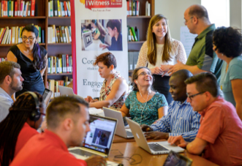
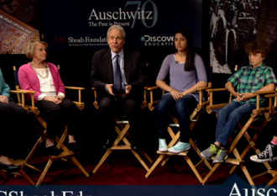
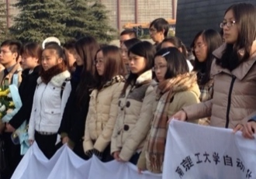
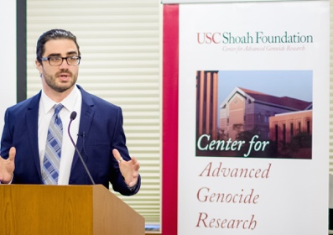
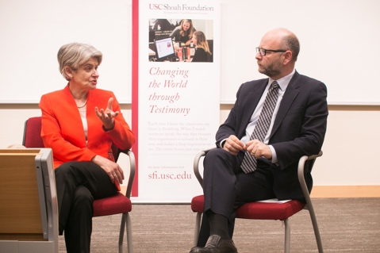
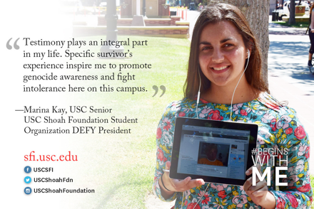
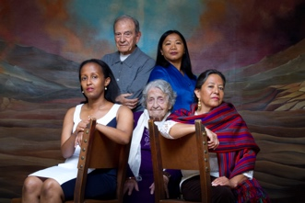
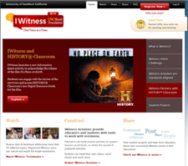
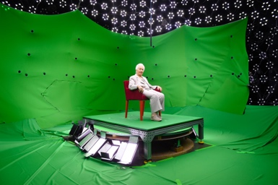
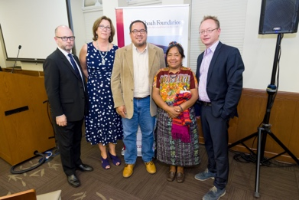
Eyes on Testimony
16 M
Notes:
Audiences:
Educators
Decision Makers
Scholars
Community
Organizations

Slide 10
Working Theory of Change
IDEA
INTEREST
INTENT
Curious
Critical
Courageous
INSIGHT
COMMITMENT
PARTICIPATION
USE
INTEGRATE
CONTRIBUTE
Participants
Notes:
SDS reviews the theory of change
Why does this matter in my own back yard??
The theory of change – applies to Racisim, Bullying, - how do we get them to make ethical choices – to participate

Slide 11
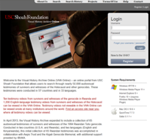
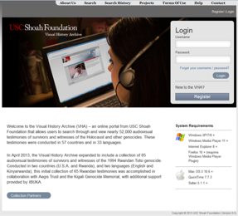
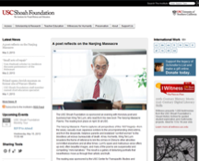
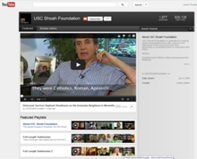
Reach & Channels
Visual History Archive®
Public
Website
Education
YouTube
Notes:
Sam
There are a 5 pathways to access the archive and we’ll look at a couple – here’s the overview:
Full Visual History Archive – Watch and search within 54,000 Institute testimonies: Now at 55 institutions scaling to 500 with ProQuest
VHAOnline – 1600 viewable testimonies , plus all 54,000 testimonies metadata – Public Access
YouTube – Limited search and browse; 96 full-length testimonies, 30 clips & 163 related videos -
Website - Featured clips, educational content, whole testimony; to browse, download & use
IWitness –1,500+ video testimonies, multimedia activities & resources for teaching purposes
Let’s take a look at the VHAOnline for a demonstration
Throw in some examples of unexpected and amazing research: Gratitude / Mapping by Experience

Slide 12
Collections and Visual History Archive Demonstration

Slide 13
Visual History Archive – Demo
Holocaust
Armenia
Nanjing
Cambodia
Guatemala
Rwanda
Notes:
The Holocaust – 1939/1945
Armenian Genocide – 1915/1917
Nanjing Massacre – 1937
Cambodian Genocide – 1975/1979
Guatemalan Genocide – 1981/1983
Rwandan Tutsi Genocide – 1994

Slide 14
Center for Advanced Genocide Research

Slide 15
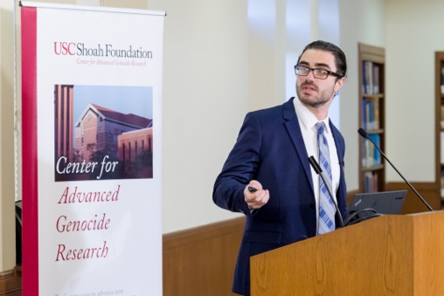
Center for Advanced Genocide Research
50+
Fellows, scholars, and conferences
since Center established in 2014
591
Courses taught with VHA at universities (cumulative)
174
Number of scholarly works published to date using VHA (cumulative)
Notes:
Sam
Launched in 2014 – It is the Academic Unit for research
In just two years, the Center for Advanced Genocide Research has become a destination for scholars around the world
It’s the academy of learning to help us understand the environment that supports genocide and how to resist it and intervene in the cycle that leads to it
SDS anecdote such as Guatemala conf Frank Marshall movie at telluride – any samples? Gratitude Study???

Slide 16
Education and IWitness Demo

Slide 17
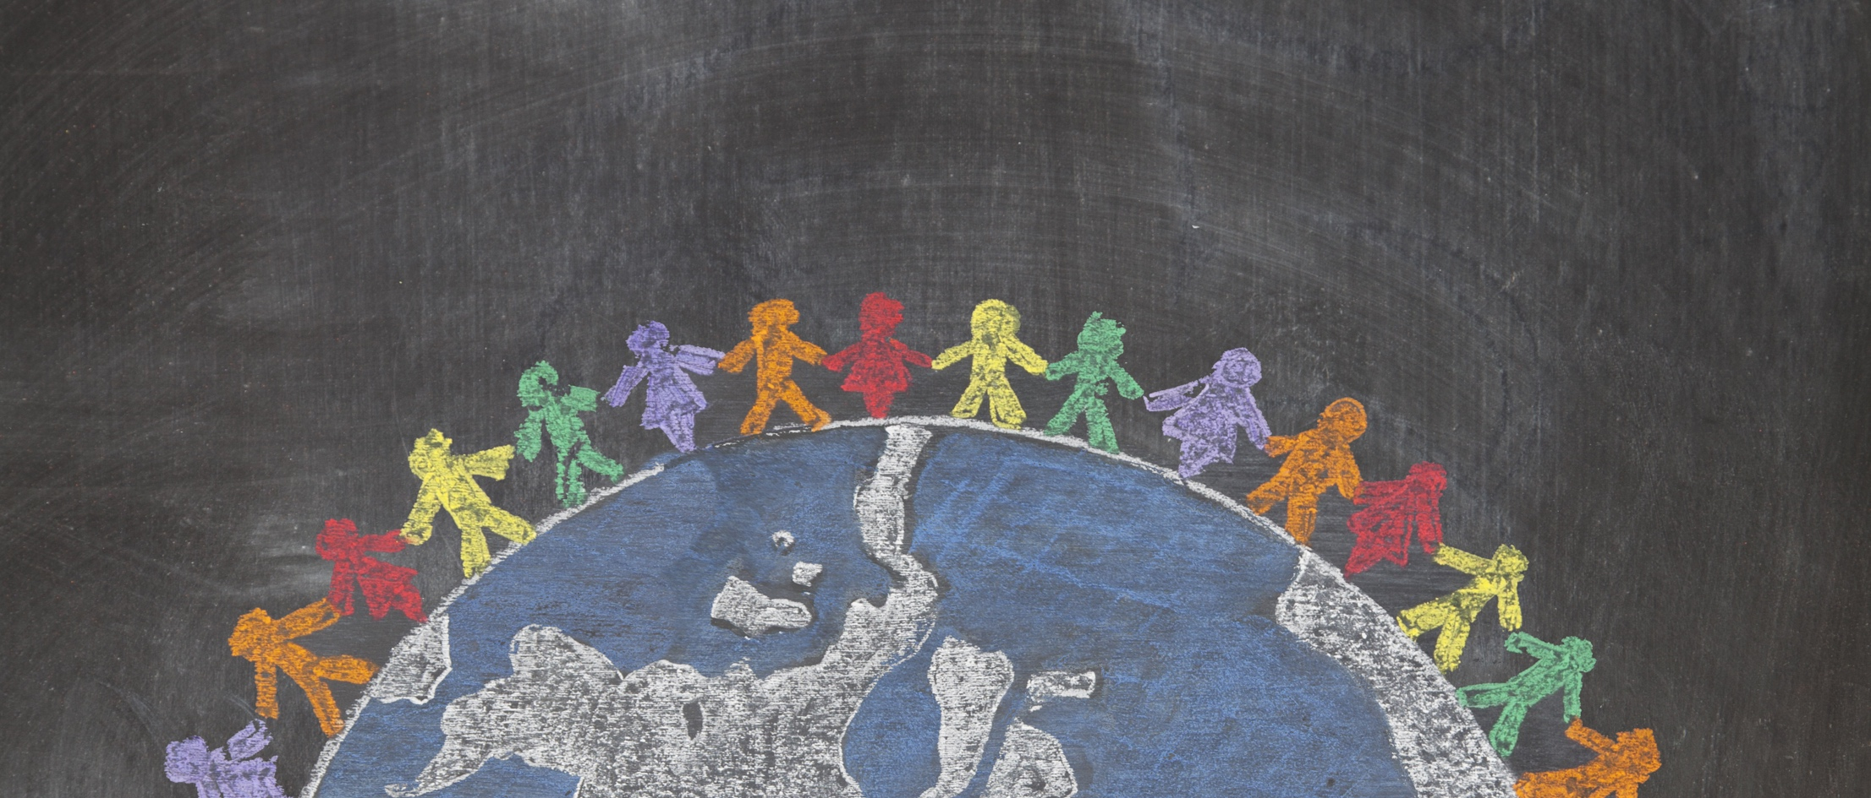
Learning Aims
knowledge & skills
critical thinking
empathy
willingness to act
value of testimony
Responsible Participation in Civil Society
Notes:
it is both an individual experience and then a collective experience for young people who engage with testimony. kids come to the table with varying levels of skills and competencies. They evolve.

Slide 18
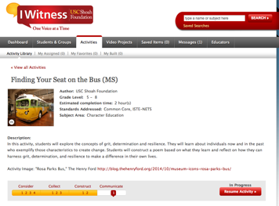
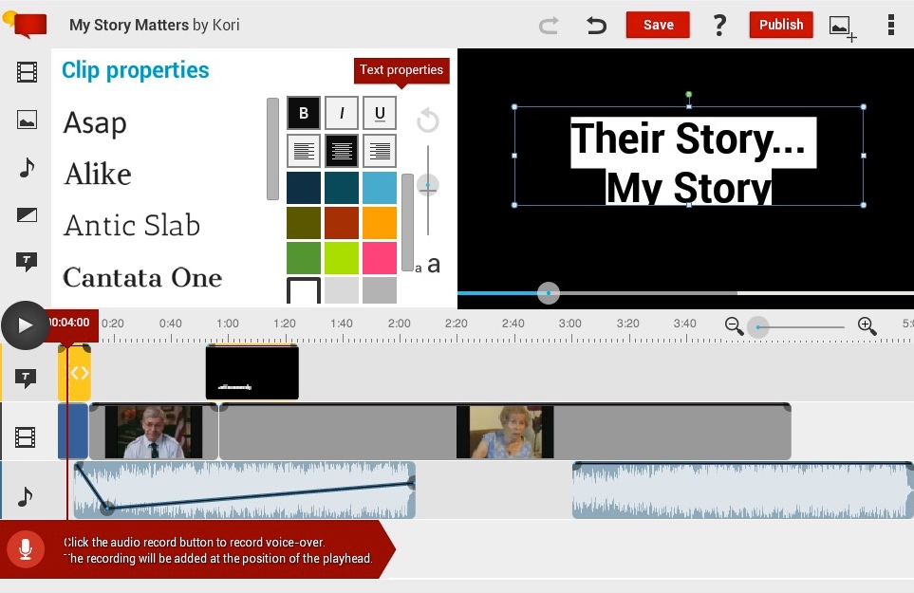
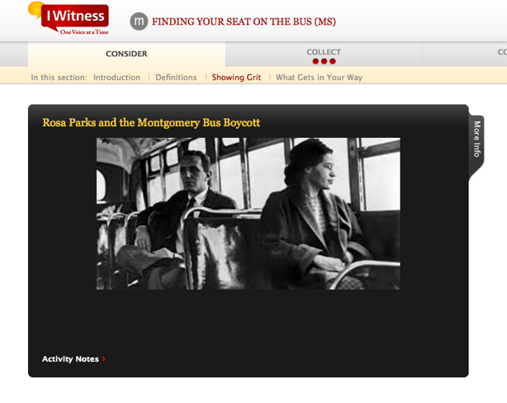
Education – IWitness
Notes:
SDS – top level this is our ON LINE Platform for teachers
As mentioned, the main way we reach teachers and students is through IWitness which is multidisciplinary, language arts, civics, history and more
Has 2000 testimonies a built-in video editor
Award-winning and standards aligned
Partnner with organizations and can imagine this with After School Matters
Teachers can build their own learning pathways
JUNE – when we meet with GLEF we will demo IWitness

Slide 19
Teaching With Testimony
Content exists in the Visual History Archive
Need for material in curriculum
Opportunity for curricular intersections
tolerance
standards
social cohesion
specific discipline
Holocaust and genocide
transliteracy
Existence and interest of local partners
Alignment with USC priorities
Funding sources (potential and existing)
Institutional priorities
Principles 2 and 3 Based on research

Slide 20
Thank You

